Slide 1


W 3_P2
RF Signals and Modulation

Slide 2
:RF Signals and Modulation
Week | Course Topic | Notes
Week | :RF Signals and Modulation | 1.7 Important dB Laws to Remember 1.8 Comparing Power Against a Reference: dBm 1.9 Measuring Power Changes Along the Signal Path 1.10 Understanding Power Levels at the Receiver 1.11 Carrying Data Over an RF Signal

Slide 3
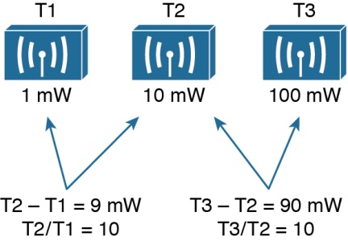
Sometimes you might need to compare the power level between two different transmitters. For example,
T2 is 9 mW stronger than T1. You might also notice that T2 is 10 times stronger than T1.
Figure 1-14 Comparing Power Levels Between Transmitters

Slide 4
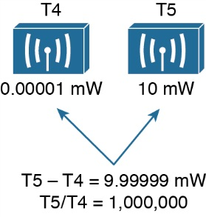
T5 is 1,000,000 times stronger than T4!
Figure 1-15 Comparing Power Levels That Differ By Orders of Magnitude

Slide 5


The base-10 logarithm function, denoted by log10, computes how many times 10
can be multiplied by itself to equal a number. For example, log10(10) equals 1 because 10 is used only once to get the result of 10. The log10(100) equals 2 because 10 is multiplied twice (10 × 10), to reach the result of 100. حلو
The decibel (dB) is a handy function that uses logarithms to compare one absolute measurement to another. It was originally developed to compare sound intensity levels, but it applies directly to power levels,
The following equation is used to calculate a dB value, where P1 and P2 are the absolute power levels of two sources:
P2 represents the source of interest, and P1 is usually called the reference value or the
source of comparison.
The difference between the two logarithmic functions can be rewritten as a single logarithm of P2 divided by P1, as follows:

Slide 6
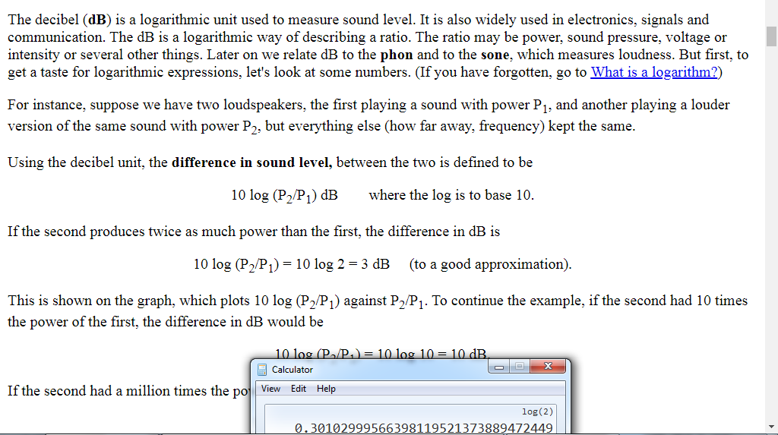

Slide 7
1.7 Important dB Laws to Remember
There are three cases where you can use mental math to make power-level comparisons using dB.
You should memorize the following three laws, with are based on dB changes of 0, 3, and 10, respectively, and are known as the Law of Zero, Law of 3s, and Law of 10s.
1- Law of Zero—A value of 0 dB means that the two absolute power values are equal.
If the two power values are equal, the ratio inside the logarithm is 1
2- Law of 3s—A value of 3 dB means that the power value of interest is double the reference value; a value of –3 dB means the power value of interest is half the reference.
3- Law of 10s—A value of 10 dB means that the power value of interest is 10 times the reference value; a value of –10 dB means the power value of interest is 1/10 of the reference.

Slide 8
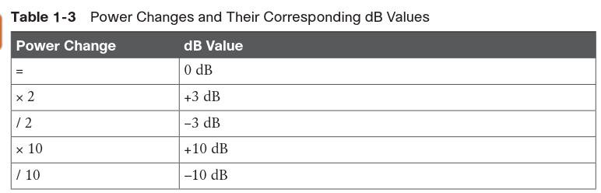

Slide 9
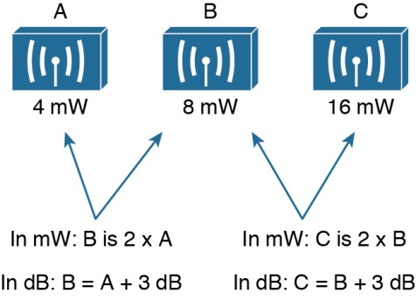
example problems to see whether you understand how to compare two power
values using dB. In Figure 1-16, sources A, B, and C transmit at 4, 8, and 16 mW, respectively. Source B is double the value of A, so it must be 3 dB greater than A. Likewise, source C is double the value of B, so it must be 3 dB greater than B.
You can also compare sources A and C. To get from A to C, you have to double A, and then double it again. Each time you double a value, just add 3 dB. Therefore, C is 3 dB + 3 dB = 6 dB greater than A.
Figure 1-16 Comparing Power Levels Using dB

Slide 10
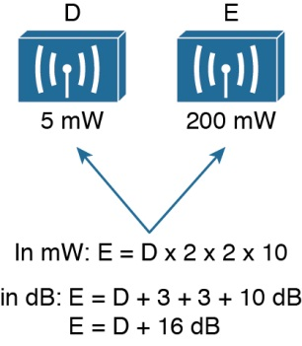
1.7 Important dB Laws to Remember
Sources D and E have power levels 5 and 200 mW. Try to figure out a way to go from 5 to
200 using only ×2 or ×10 operations. You can double 5 to get 10, then double 10 to get 20, and then multiply by 10 to reach 200 mW. Next, use the dB laws to replace the doubling and ×10 with the dB equivalents. The result is E = D + 3 + 3 + 10 or E = D + 16 dB.
Figure 1-17 Example of Computing dB with Simple Rules

Slide 11
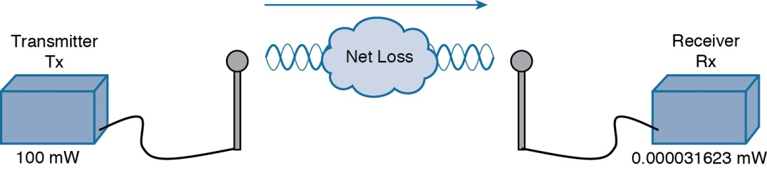

1.8 Comparing Power Against a Reference: dBm
Figure 1-18 shows a simple scenario with a transmitter and a receiver. Nothing in the real world is ideal, so assume that something along the path of the signal will induce a net loss.
Figure 1-18 Example of RF Signal Power Loss
You could leverage the handy dB formula to compare the received signal strength to the transmitted signal strength, as long as you can remember the formula and have a calculator near by:
The net loss over the signal path turns out to be a decrease of 65 dB. Knowing that, you decide to try a different transmit power level to see what would happen at the receiver

Slide 12
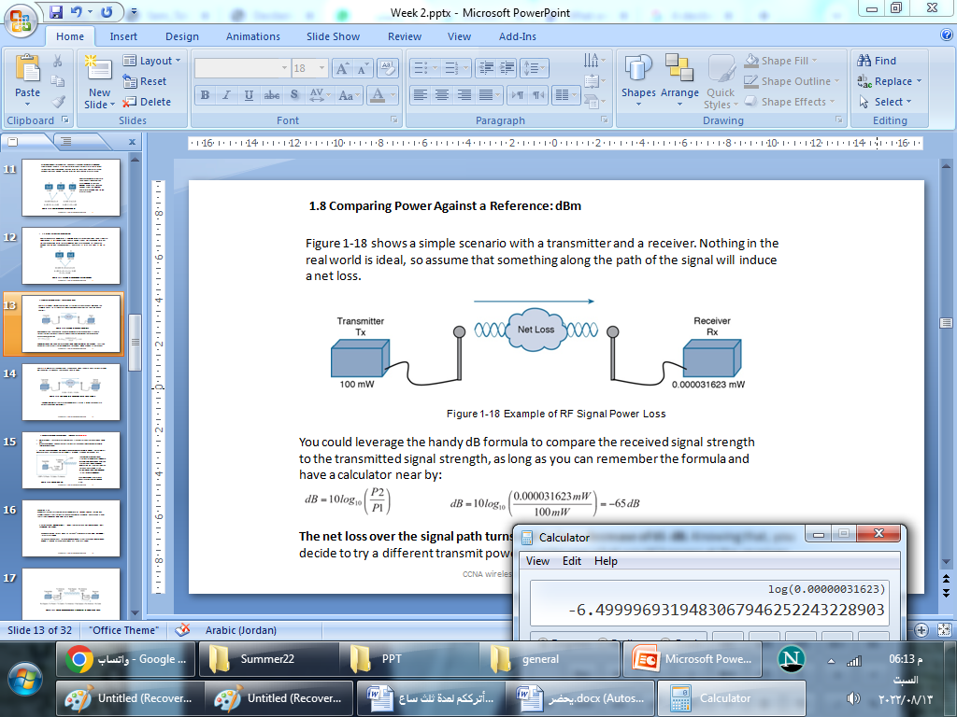
1.8 Comparing Power Against a Reference: dBm
Figure 1-18 shows a simple scenario with a transmitter and a receiver. Nothing in the real world is ideal, so assume that something along the path of the signal will induce a net loss.
Figure 1-18 Example of RF Signal Power Loss
You could leverage the handy dB formula to compare the received signal strength to the transmitted signal strength, as long as you can remember the formula and have a calculator near by:
The net loss over the signal path turns out to be a decrease of 65 dB. Knowing that, you decide to try a different transmit power level to see what would happen at the receiver

Slide 13
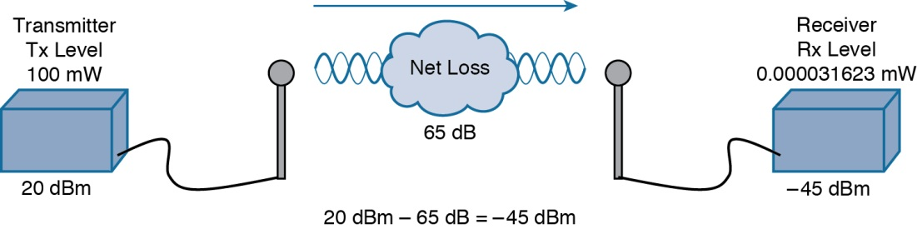
Figure 1-19. Notice that the dBm values can be added along the path: The transmitter dBm plus the net loss in dB equals the received signal in dBm.
Figure 1-19 Subtracting dB to Represent a Loss in Signal Strength
In wireless networks, the reference power level is usually 1 mW, so the units are designated by dBm (dB-milliwatt).

Slide 14
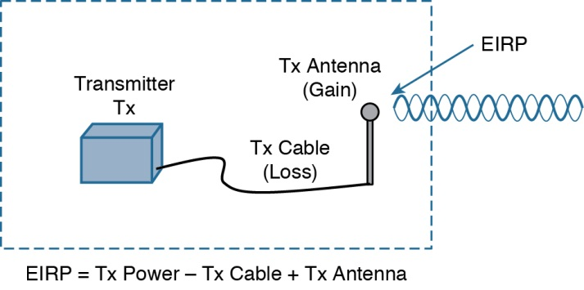
1.9 Measuring Power Changes Along the Signal Path غير مهم
Up to this point, this chapter has considered a transmitter and its antenna to be a single unit.
When an antenna is connected to a transmitter, it provides some amount of gain to the resulting RF signal.
By itself, an antenna does not generate any amount of absolute power. In other words,
when an antenna is disconnected, no milliwatts of power are being pushed out of it
the complete combination of transmitter power level, the length of cable, and the antenna gain, you can figure out the actual power level that will be radiated from the
antenna. This is known as the effective isotropic متماثل radiated power (EIRP), measured in dBm.
a system cannot radiate signals higher than a maximum allowable
EIRP. شيء طبيعي
Figure 1-20 Calculating EIRP

Slide 15
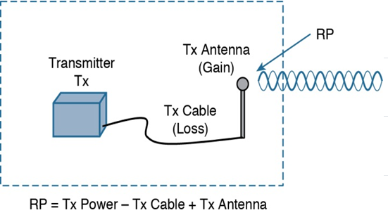
قانون مهم لحساب قوة الاشاره المرسله
Radiation Power RP
Calculating EIRP
Suppose a transmitter is configured for a power level of 10 dBm (10 mW). A cable with
5-dB loss connects the transmitter to an antenna with an 8-dBi gain.
The resulting RP of the system is
10 dBm – 5 dB + 8 dBi, or 13 dBm.

Slide 16
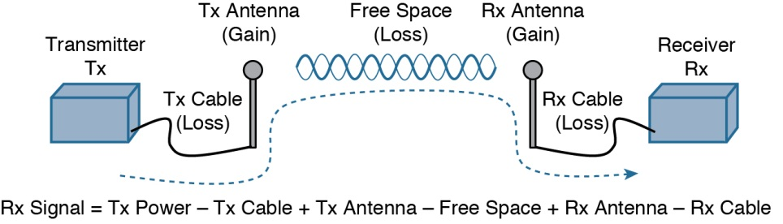
Figure 1-21 Calculating Received Signal Strength Over the Path of an RF Signal

Slide 17
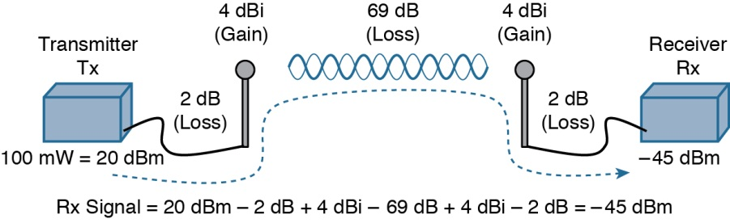
Figure 1-22 Example of Calculating Received Signal Strength

Slide 18
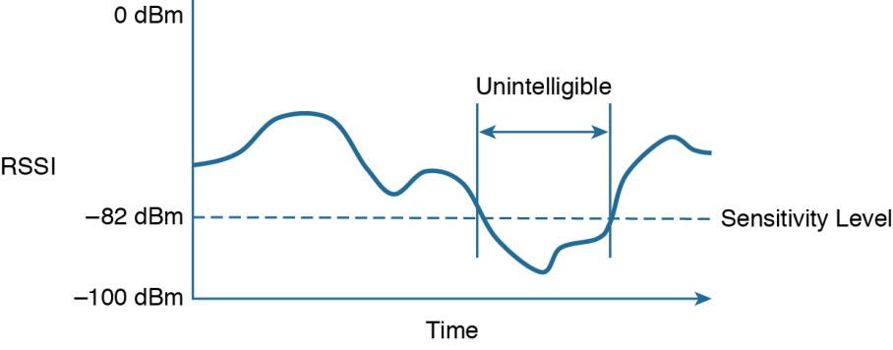
1.10 Understanding Power Levels at the Receiver الثلاثاء 1/11
at the receiving end of the signal path, a receiver expects to find a signal on a predeter-
mined frequency, with enough power to contain useful data. Receivers measure a signal’s power in dBm according to the received signal strength indicator (RSSI) scale.
Figure 1-23 Example of Receiver Sensitivity Level
When you work with wireless LAN devices, the EIRP levels leaving the transmitter’s antenna normally range from 100 mW down to 1 mW
The corresponding range of received signal levels is from 0 dBm down to about –100 dBm.
Therefore, the RSSI of a received signal can range from 0 to –100

Slide 19
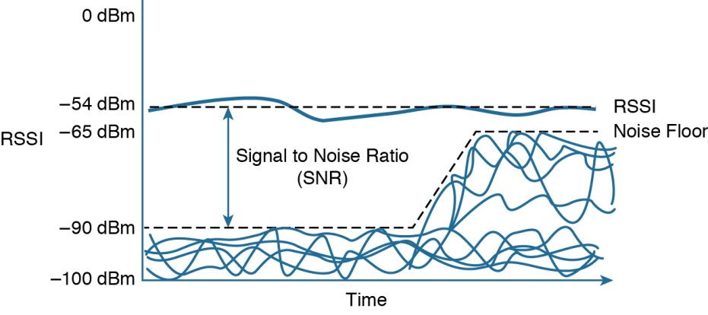
its signal strength must be greater than the noise floor by a decent amount so that it can be received and understood correctly.
The difference between the signal and the noise is called the signal-to-noise ratio (SNR), measured in dB. A higher SNR value is preferred.
Figure 1-24 shows the RSSI of a signal compared with the noise floor that is received. The RSSI averages around –54 dBm. On the left side of the graph, the noise floor is –90 dBm.
The resulting SNR is –54 dBm – (–90) dBm or 36 dB. Toward the right side of the graph, the noise floor gradually increases to –65 dBm, reducing the SNR to 11 dB. The signal is so
close to the noise that it might not be usable.
Figure 1-24 Example of a Changing Noise Floor and SNR

Slide 20
1.11 Carrying Data Over an RF Signal
This basic RF signal is called a carrier signal because it is used to carry other useful
information. With AM and FM radio signals, the carrier signal also transports audio signals.
TV carrier signals have to carry both audio and video. Wireless LAN carrier signals
must carry data.
To add data onto the RF signal, the frequency of the original carrier signal must be preserved. Therefore, there must be some scheme of altering some characteristic of the carrier signal to distinguish a 0 bit from a 1 bit.

Slide 21
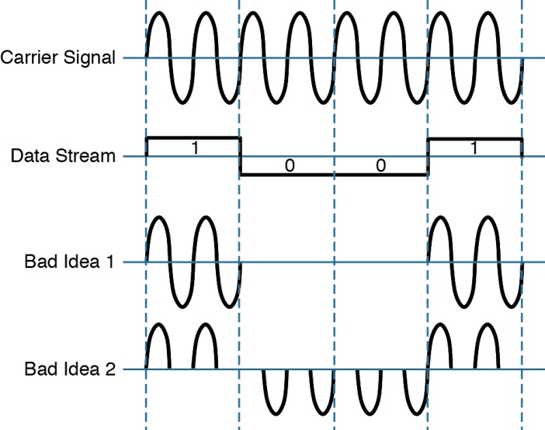
Figure 1-25 shows a carrier signal with a constant frequency. The data bits 1001 are to be sent over the carrier signal, but how?
This is known as modula-
tion, where the carrier signal is modulated or changed according to some other source. At the receiver, the process is reversed; demodulation interprets the added information based on changes in the carrier signal.
Figure 1-25 Poor Attempts at Sending Data Over an RF Signal

Slide 22
RF modulation schemes generally have the following goals:
■ Carry data at a predefined rate
■ Be reasonably immuneمناعه to interference and noise
■ Be practical to transmit and receive
Due to the physical properties of an RF signal, a modulation scheme can alter only the following attributes:
■ Frequency, but only by varying slightly above or below the carrier frequency
■ Phase
■ Amplitude
Three spread-spectrum categories, which are discussed in subsequent sections:
■ Frequency-hopping spread spectrum (FHSS) القفز الترددي
■ Direct-sequence spread spectrum (DSSS)
■ Orthogonal frequency-division multiplexing (OFDM)

Slide 23
24-28 Less Important

Slide 24
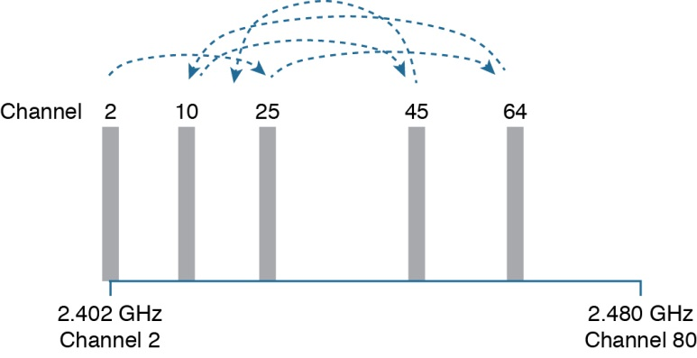
Frequency-hopping spread spectrum (FHSS)
Early wireless LAN technology
The wireless band was divided into 79 channels or fewer, with each channel being 1 MHz wide. To avoid narrowband interference, transmissions would need to continuously “hop” between frequencies all across the band. This is known
as frequency-hopping spread spectrum.
Figure 1-26 shows an example of how the FHSS technique works, where the sequence begins on channel 2, then moves to channels 25, 64, 10, 45, and so on
Figure 1-26 Example FHSS Channel-Hopping Sequence

Slide 25
Whatever advantage FHSS gained avoiding interference was lost because of the following
limitations:
■ Narrow 1-MHz channel bandwidth, limiting the data rate to 1 or 2 Mbps.
■ Multiple transmitters in an area could eventually collide and interfere with each other on the same channels.

Slide 26
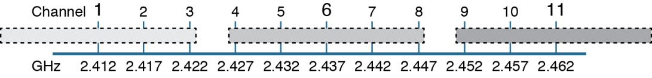
Direct-sequence spread spectrum (DSSS)
Direct-sequence spread spectrum uses a small number of fixed, wide channels that can support complex modulation schemes and somewhat scalable data rates. Each channel is 22 MHz wide—a much wider bandwidth compared with the maximum supported 11-Mbps data rate, but wide enough to augmentلزيادة the data by spreading it out and making it more resilient to disruptionاضطراب . In the 2.4-GHz band where DSSS is used, there are 14 possible channels, but only 3 of them that do not overlap. Figure 1-27 shows how channels 1, 6, and 11 are normally used.
Figure 1-27 Example Non-overlapping Channels Used for DSSS
From CCNA Wireless 200-355 Official Cert Guide, by David Hucaby (1587144573) Copyright © 2016 Pearson Education, Inc. All rights reserved.

Slide 27
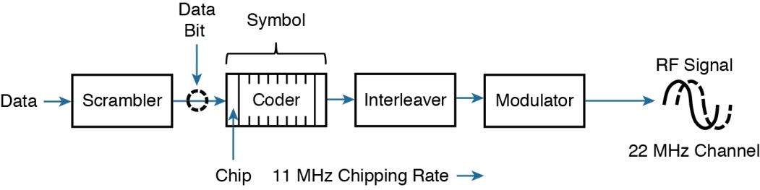
Direct-sequence spread spectrum (DSSS)
Scrambler—The data waiting to be sent is first scrambled in a predetermined manner
so that it becomes a randomized string of 0 and 1 bits rather than long sequences of 0
or 1 bits.
Coder—Each data bit is converted into multiple bits of information that contain carefully crafted patterns that can be used to protect against errors due to noise or interference.
Each of the new coded bits is called a chip. The complete group of chips representing
a data bit is called a symbol. DSSS uses two encoding techniques: Barker codes(صوت جهور للدخوا) and Complementary Code Keying (CCK)مفتاح محدد سلفا.
Modulator—The bits contained in each symbol are used to alter or modulate the phase
of the carrier signal. This enables the RF signal to carry the binary data bit values.
Figure 1-28 Functional Blocks Used in a DSSS Transmitter

Slide 28
1-Mbps Data Rate
To minimize the effect of a low SNR and data loss in cases of narrowband interference, each bit of data is encoded as a sequence of 11 bits called a Barker 11 code.
Each bit in a Barker chip can be transmitted by using the differential binary phase shift keying (DBPSK) modulation scheme. The phase of the carrier signal is shifted or rotated according to the data bit being transmitted, as follows:
0: The phase is not changed.
1: The phase is “rotated” or shifted 180 degrees, such that the signal is suddenly inverted.
2-Mbps Data Rate
It is possible to couple the 1-Mbps strategy with a different modulation scheme to double the data rate using differential quadrature phase shift keying (DQPSK).
The bit patterns produce the following phase shifts:
■ 00—The phase is not changed.
■ 01—Rotate the phase 90 degrees.
■ 11—Rotate the phase 180 degrees.
■ 10—Rotate the phase 270 degrees.

Slide 29
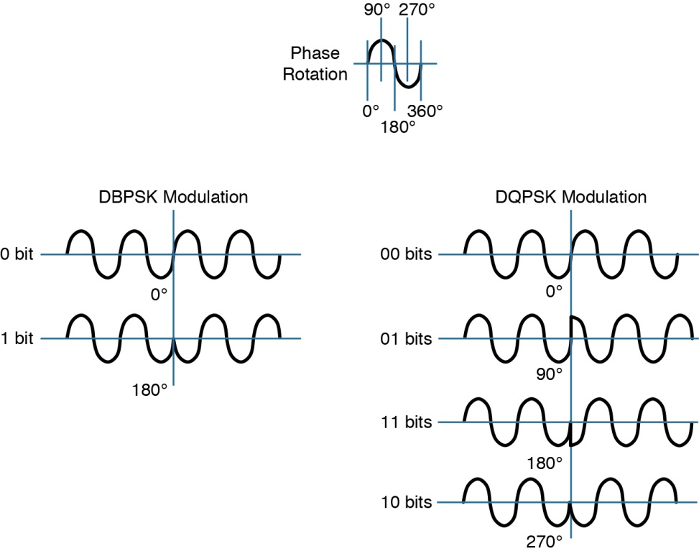
Figure 1-29 Example Phase Changes During DBPSK and DQPSK Modulation

